Slide 1

Airport Management System
Pranav Arora (2010990537)
Vishal Kumar (2010990786)
Saksham Kaushal (2010990625)
Shivam Soni (2010990665)
Paranav Mahajan (2010990514)

Slide 2
Introduction
We made this project to make the work easier for the managing team of the airport. With this they can easily access the details of flights, details of passengers travelling, status of flights, Also it can help them Monitor the flight schedule.

Slide 3
Case study Informal Description
In this system a passenger can see how many seats are available in his particular flight, the flight status, get details of seats and check if he is eligible for discounts.
If an employee travels, he/she is also eligible for employee discounts

Slide 4
TABLES
AIRLINE
AIRPORT
CABIN_DATA
CANCEL_BOOKING
CITY
DEPARTMENT_DETAILS
DOCKED_AIRLINE
EMPLOYEE
EMPLOYEE DETAIL
FLIGHT_DATA
PASSENGER_DATA
PASSENGER_DETAILS
TICKET
TICKET_DATA

Slide 5
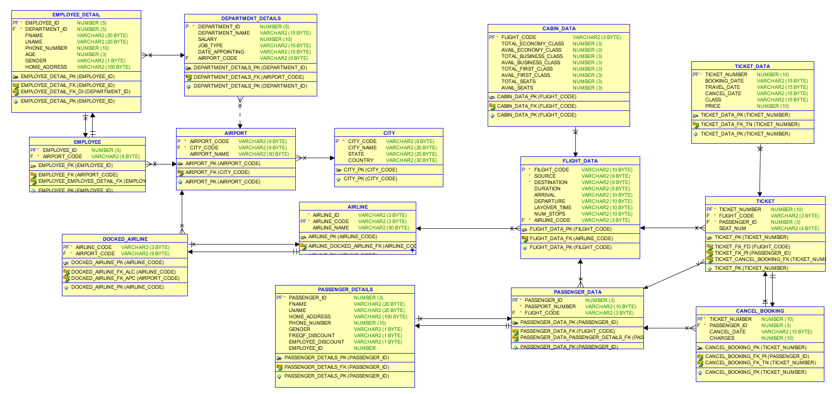
Case Study Logical Model

Slide 6
Case Study Physical Model
CREATE table "CITY" (
"CITY_CODE" VARCHAR2(9) NOT NULL,
"CITY_NAME" VARCHAR2(20),
"STATE" VARCHAR2(25),
"COUNTRY" VARCHAR2(30),
constraint "CITY_PK" primary key ("CITY_CODE"));
CREATE table "AIRPORT" (
"AIRPORT_CODE" VARCHAR2(9) NOT NULL,
"CITY_CODE" VARCHAR2(9) NOT NULL,
"AIRPORT_NAME" VARCHAR2(50),
constraint "AIRPORT_PK" primary key ("AIRPORT_CODE"));
CREATE table "TICKET" (
"TICKET_NUMBER" NUMBER(10) NOT NULL,
"FLIGHT_CODE" VARCHAR2(10) NOT NULL,
"PASSENGER_ID" NUMBER(3) NOT NULL,
"SEAT_NUM" VARCHAR2(4),
constraint "TICKET_PK" primary key ("TICKET_NUMBER"));
CREATE table "AIRLINE" (
"AIRLINE_ID" VARCHAR2(3) NOT NULL,
"AIRLINE_CODE" VARCHAR2(3) NOT NULL,
"AIRLINE_NAME" VARCHAR2(50),
constraint "AIRLINE_PK" primary key ("AIRLINE_CODE"));
CREATE table "DOCKED_AIRLINE" (
"AIRLINE_CODE" VARCHAR2(3) NOT NULL,
"AIRPORT_CODE" VARCHAR2(9) NOT NULL,
constraint "DOCKED_AIRLINE_PK" primary key ("AIRLINE_CODE"));
CREATE table "PASSENGER_DATA" (
"PASSENGER_ID" NUMBER(3) NOT NULL,
"PASSPORT_NUMBER" VARCHAR2(10) NOT NULL,
"FLIGHT_CODE" VARCHAR2(10) NOT NULL,
constraint "PASSENGER_DATA_PK" primary key ("PASSENGER_ID"));

Slide 7
Case Study Interactive Queries
INSERT INTO CITY ("CITY_CODE","CITY_NAME","STATE","COUNTRY") VALUES('LKUS','Louisville','Kentucky','United States');
INSERT INTO AIRLINE ("AIRLINE_ID","AIRLINE_NAME","AIRLINE_CODE") VALUES('AI','Air India Limited','098');
INSERT INTO AIRPORT ("AIRPORT_NAME","AIRPORT_CODE","CITY_CODE") VALUES('Louisville International Airport','SDF','LKUS');
INSERT INTO DOCKED_AIRLINE ("AIRLINE_CODE","AIRPORT_CODE") VALUES('001','SDF');
INSERT INTO FLIGHT_DATA
( "FLIGHT_CODE","SOURCE","DESTINATION","DURATION","ARRIVAL","DEPARTURE","LAYOVER_TIME","NUM_STOPS","AIRLINE_CODE") VALUES('AI2014','BOM','DFW','24hr','02:10','03:15' ,'3', '1','098');
BEGIN
NEW_EMPLOYEE_PRO('SDF','118','Pratham','arora',5345679512,27,'M','731 Fondren, Houston, TX');
END;
BEGIN
REM_PASSENGER_PRO(10,123);
END;
BEGIN
NEW_PASSENGER_PRO('A1234568','LH9876','AKSHAT','SHARMA', '7720 MCCALLUM BLVD, APT 1082, DALLAS, TX',9080367266,'M','N','N','','Economy','a023',15000);
END;

Slide 8
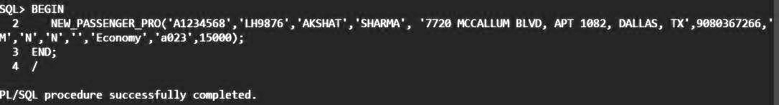
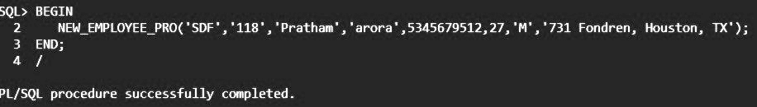
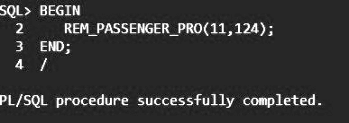
Output Screen Shots

Slide 9
Conclusion and Future Work
While working on this project, we learnt a lot about creating a database and implementing all the queries related to creation of the database, modifying it and fetching the data from it. We have a good hold on the concepts related to ER diagrams and normalization now.
We also learned about procedures, sequences by this project and triggers.
Future Work
We will be adding more features with Pl/Sql procedures.
Also we will try to make it more interactive.

Slide 10
THANK YOU

